Slide 1
Sensing and Instrumentation Practice
SMART TRAFFIC LIGHT SYSTEM
TEAM MEMBERS
EC22B1025
EC22B1055
EC22B1062
EC22B1064

Slide 2
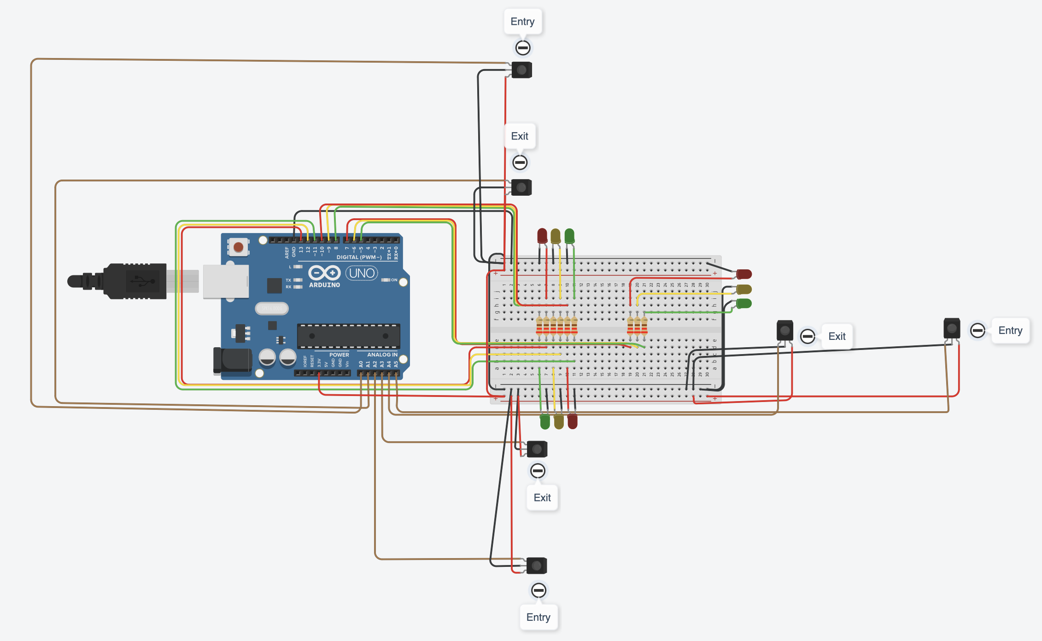
CIRCUIT DIAGRAM

Slide 3
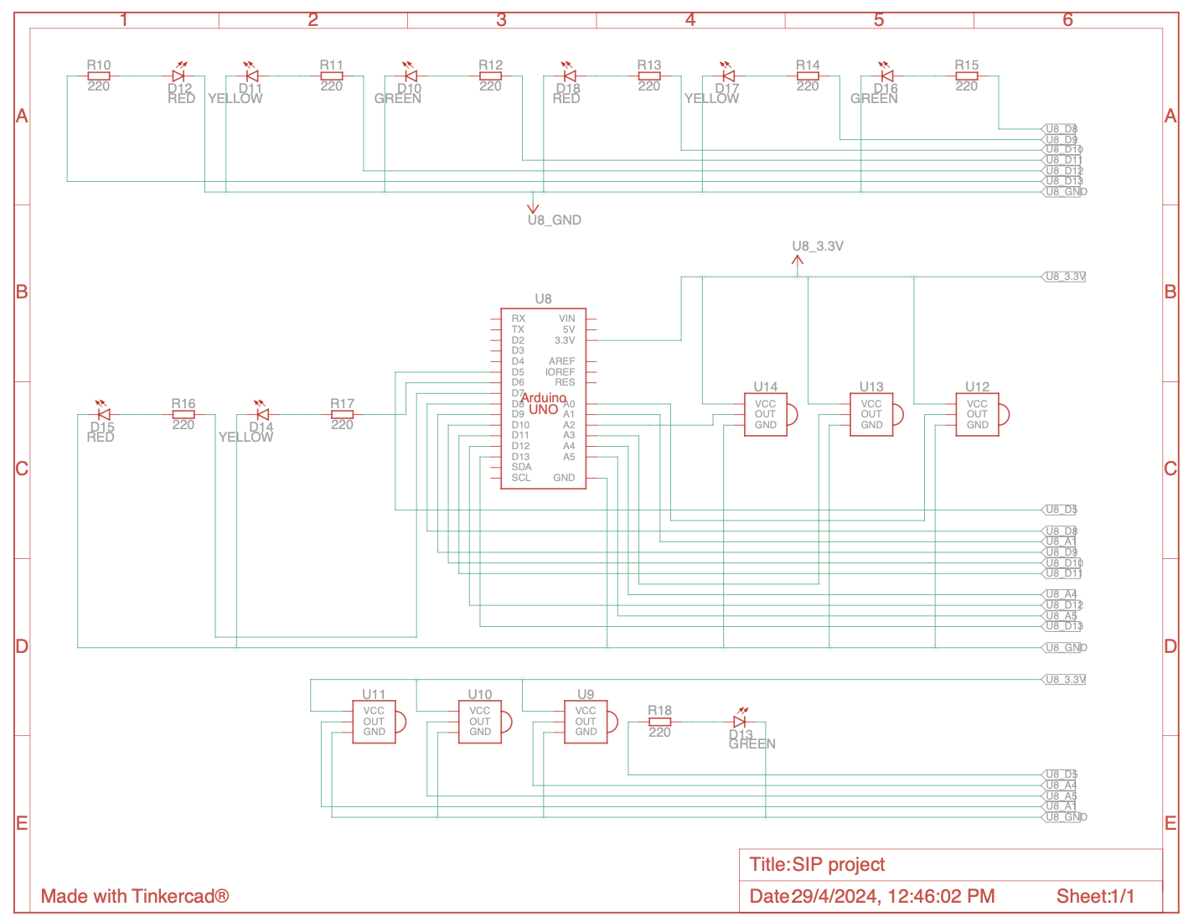
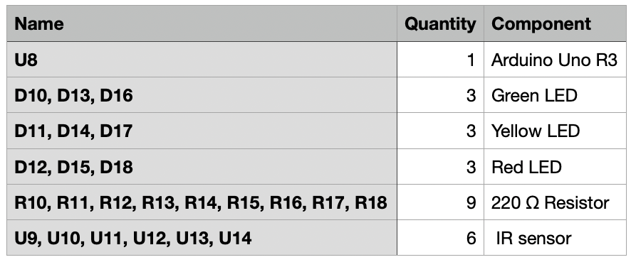
Schematic View of Circuit Diagram
Components used

Slide 4
Components Description
1. Infrared Sensors (IR): These sensors detect vehicles at each intersection by emitting and receiving infrared radiation.
2. Traffic Light module: Consists of red, yellow, and green LEDs. The code controls these lights to manage traffic flow by dynamically adjusting priorities based on vehicle counts at each intersection.
WORKING PRINCIPLE
This project presents a smart traffic management system for three intersections. It utilizes infrared sensors to detect vehicle presence and absence at each intersection, incrementing and decrementing counts accordingly. Based on the counts, it dynamically adjusts traffic light priorities, ensuring smooth traffic flow.

Slide 5
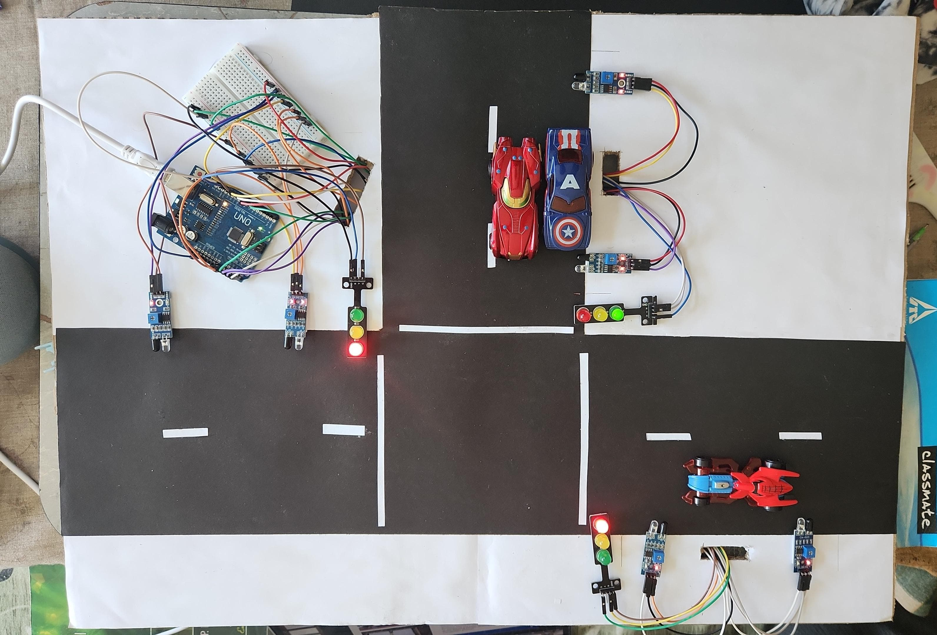
Hardware Output:

